Slide 1

WebScraping bienici.fr for cities Tourcoing and Roubaix
Subhamoy Dam

Slide 2
Challenges Faced
  Accounting for waiting time while scraping the data
  Handling pop up box while scraping
  Changing pages while the scraping operations
  Cleaning the data
  Handling of cases where variable is not present

Slide 3
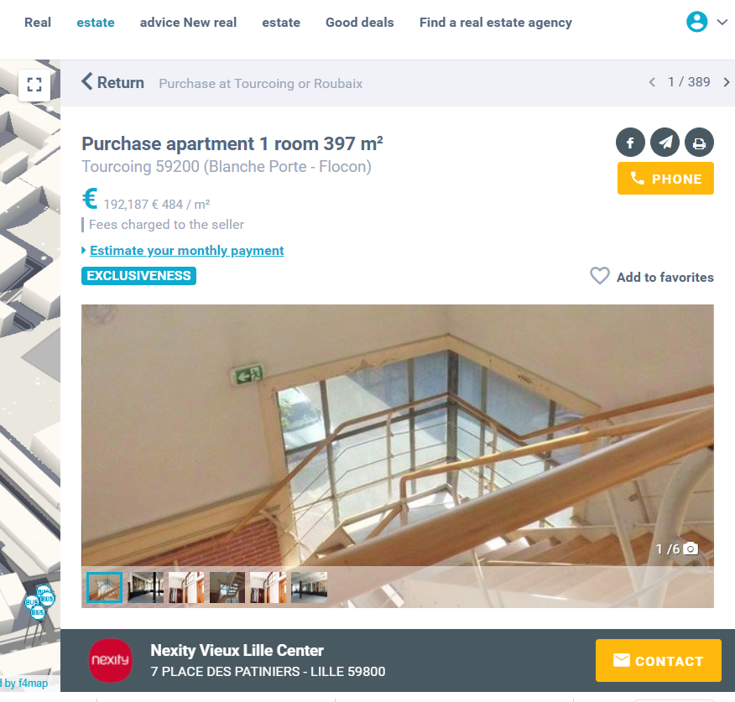
Simulating click and changing page

Slide 4
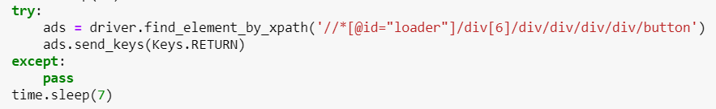
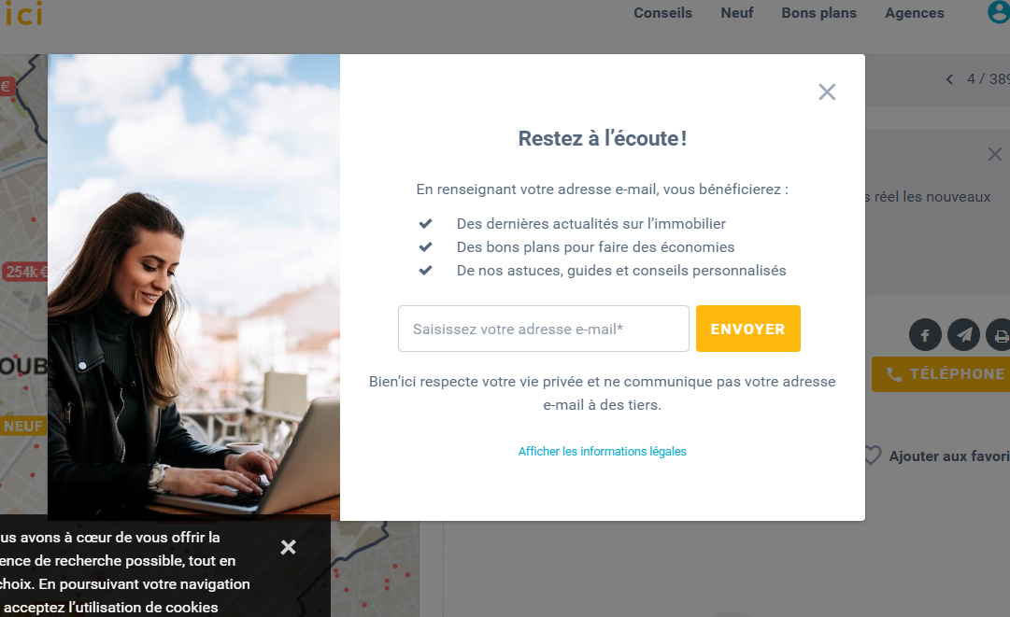
Handling popups

Slide 5
Variables collected:
Energy Label1
Reference
Last modified date
Published date
Municipality
Full Address
Postalcode
Euro/m²
Living Surface Area
Total Surface Area
Availability of :
  Price
  Heating
  No. of rooms
  Garden
  Terrace
  Cellar
  Parking
  Elevator

Slide 6
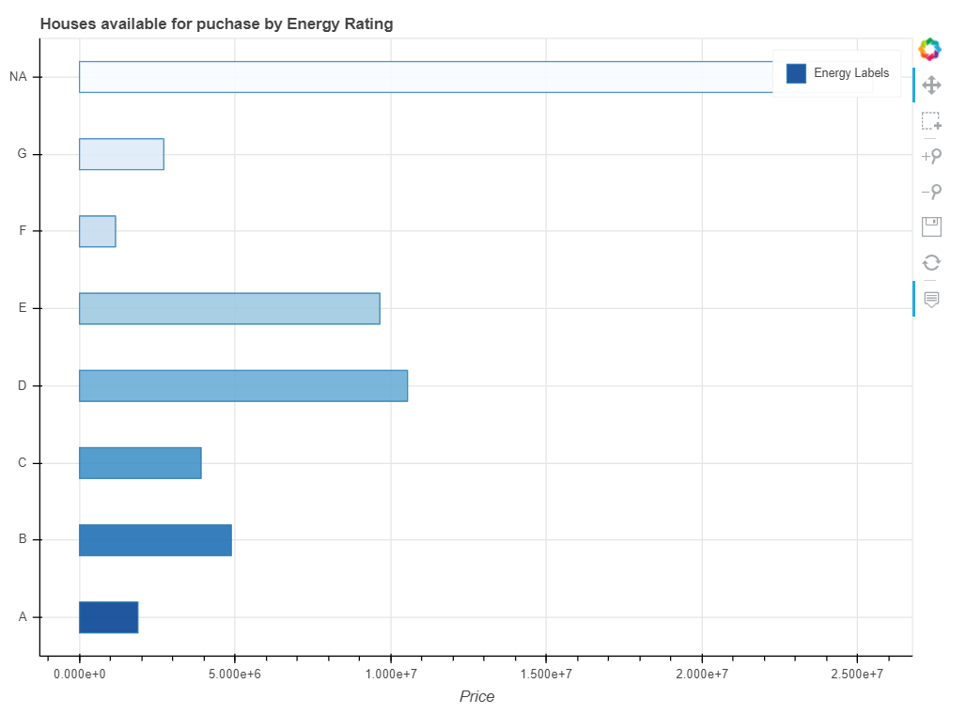
Dashboard using Bokeh

Slide 7


